Slide 1

Lecture 13: Teaching writing

Slide 2
Approaches to teaching writing
Product Oriented Approach
concentrates on the final product rather than on the writing process
Accuracy is the criterion of good writing (the focus is on language structures)
Process Oriented Approach
It stresses the teacher’s role throughout the writing process (guiding and providing feedback on learner’s multiple drafts)

Slide 3
Writing is a recursive and creative process.
Writing process:
At this stage, learners get introduced to the topic. Then, they start to generate ideas about that topic using their prior knowledge or personal experiences.
Referred to as First Drafting. Learners start to write focusing much more on expressing their ideas not on the mechanics of writing.
At this stage the teacher is there to guide and to provide feedback on learner’s work.
Pre-writing
Writing

Slide 4
Writing process
Revising
Learners reconsider what they have written taking into account their teacher's comments. Learners examine their texts, critically to make changes at both levels: form and content.
Learners proofread their final drafts for further error checking before handing them to the teacher.
Editing

Slide 5
Pre-writing strategies
Brainstorming: listing freely all the ideas related to the topic
Journalistic questions. Learners ask and answer ‘wh questions’ about a given topic
Clustering. The writer here groups ideas together using lines and circles to show connections between them

Slide 6
Practice
Unit: Make peace
SWBAT write a poem to denounce prejudices associated with certain groups such as men, women, teens, and Muslims……
Write it right

Slide 7
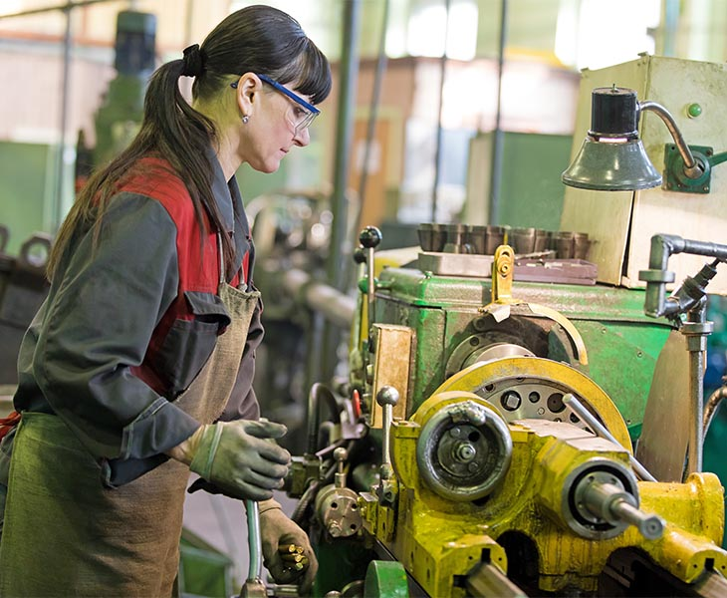
Pre-writing
Look at the picture given and with your partner discuss the following questions:
What does the picture show?
In our society, do people think that woman can do such kind of work? (are these beliefs correct or false)
List other three prejudices (false ideas) about women

Slide 8
In pairs, complete the spidermap shown below writing at least three (3) prejudices about each group
Prejudice
1 ……………………….
2 ……………………….
3 ………………………..
1 ……………………….
2…………………………
3…………………………
1……………………………
2…………………………….
3………………………….....
Men
Teens
Muslims

Slide 9
Use ideas from the previous task to complete the poem denouncing prejudices (you can add other ideas).
Down with prejudices
Just because I am a woman
It doesn’t mean I can not be a mechanic
It doesn’t mean I ……………..
It doesn’t mean I ………………
I am a woman, SO I can ……………….

Slide 10
Down with prejudices
Just because I am a teen
It doesn’t mean I am careless and rude
It doesn’t mean I can not ……………..
It doesn’t mean I ………………………….
I am a teenager and I am ……………….
I am a teenager and I can ……………….

